Slide 1
QUIZ APPLICATION

Slide 2
MINI PROJECT
TITLE OF PROJECT : Quiz application
REGISTER NUMBER : 192211469
192211393
192211385
NAME : K . Manjunath Naidu
P . Vijay Kumar
S . Devendra
CONSULTANT PROFESSOR
[DR.Senthel kumar]

Slide 3
TABLE OF CONTENTS
1 | Abstract | 1
2 | Introduction | 2
3 | About Python | 3
4 | Flow Chart | 4
5 | Code | 5-6
6 | Output Screen | 7
7 | Conclusion | 8

Slide 4
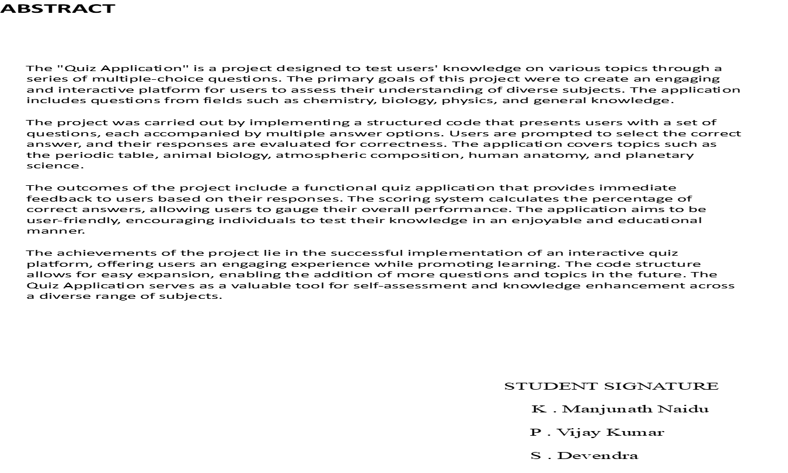

Slide 8
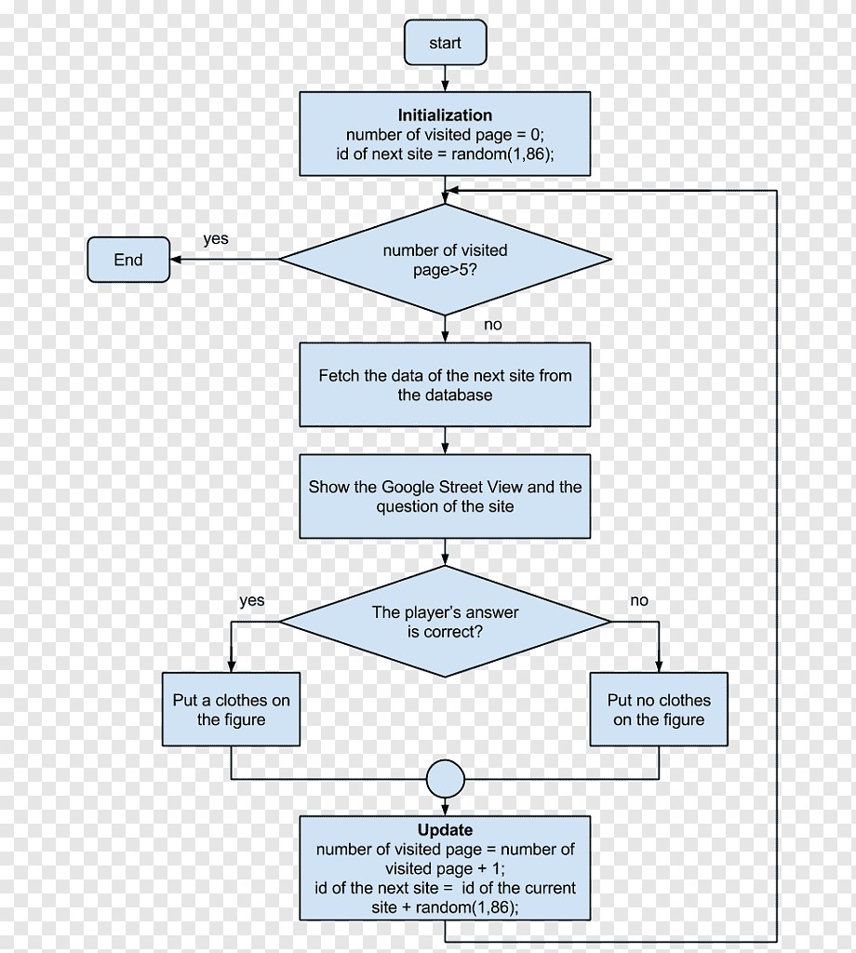
FLOW CHART

Slide 11
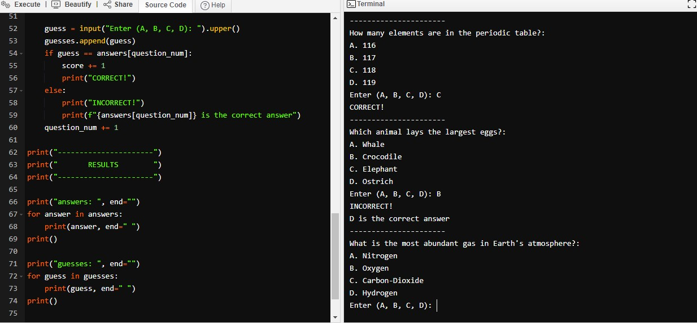
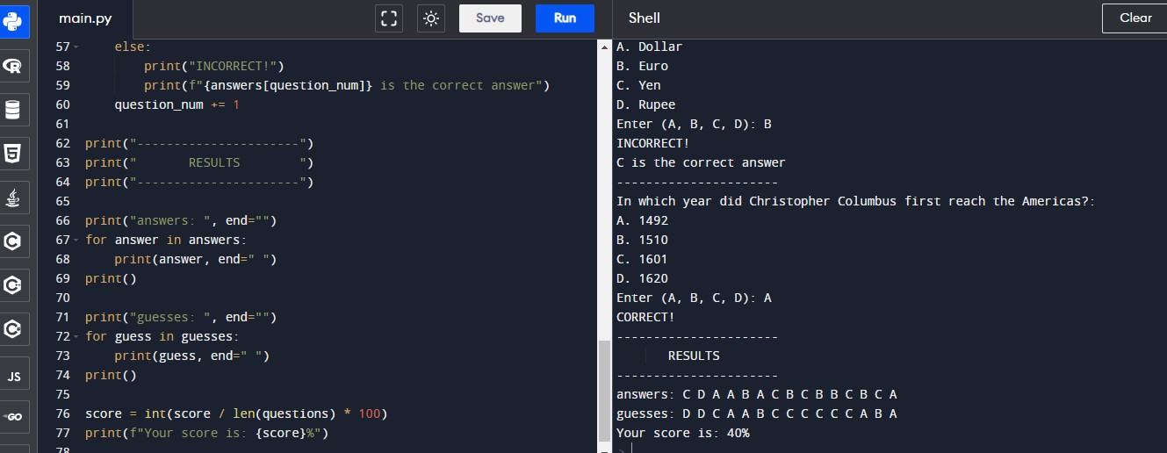
OUTPUT SCREEN:

Slide 12
Quiz app system report in python. Thesis, we have focused on the automated system, which replaces the manual quiz system. But the interesting thing is that the thesis is not just a quiz system; it has its own intelligent capability. This was actually our target feature of our thesis. Quiz Applications Report in Python .We have tried to introduce at the same time conducting tests to uncover errors associated with interfacing. The objective is to take unit tested components and build a program structure that has been dictated by the design. We prefer the Top-down integration testing as a testing approach for our project. The Top-down integration testing is an incremental approach to construction of program structure. Modules are integrated by moving downward through the control hierarchy, beginning with the main control module. The main control module is used as a test driver and others are substituted for all components directly subordinate to the main control module. Depth-first integration would integrate all components on a major control path of a structure. Selection of a major path is somewhat arbitrary and depends on application specific characteristics.

Slide 13


